Slide 1



Spotify Streaming Charts Analysis
Presented By
Stuti Upadhyay and Philip Appiah

Slide 2

Introduction
With Spotify Wrapped happening this Wednesday let’s take a look at the Global Top 200 Chart Analytics from the start of January 2020.
About the Dataset:
Size : 1.46 GB
This is a dataset of all the "Top 200" and "Viral 50" charts published globally by Spotify. This is a collection that starts from January of 2020.
It is to be noted that the streams value is "NULL" for the Viral 50 category.
Source:https://www.kaggle.com/datasets/dhruvildave/spotify-charts

Slide 3
Columns :
Rank: Position of the track on the chart.
Track Name: Name of the track.
Artist: Artist(s) performing the track.
Streams: Number of times the track was streamed.
Date: Date of the chart.
Region: Geographical region of the chart.
Some of the initial observations are;
Dataset covers Spotify’s Top 200 charts starting from January 2020.
Regions include global and country-specific charts.
Each date represents a snapshot of streaming data for that day.
Data Overview

Slide 4
Basic Data Exploration
The dataset contains 8,984,060 unique artists and 8,984,060 unique tracks, indicating that each track is associated with a distinct artist.
The dataset spans from January 1, 2020, to December 31, 2021, covering two years of streaming data.
Bad Bunny was the most frequent artist in the dataset, appearing 115,793 times in the charts.

Slide 5
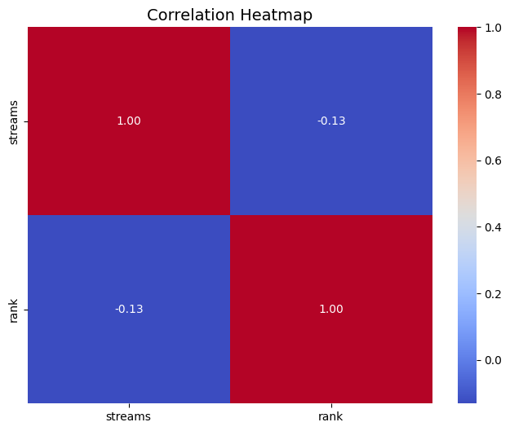
Exploratory Data Analysis
The correlation between rank and streams is 0.13, indicating a weak negative relationship. Higher-ranked tracks (closer to 1) tend to have slightly more streams, but the correlation is not strong enough to suggest a significant dependency.

Slide 6
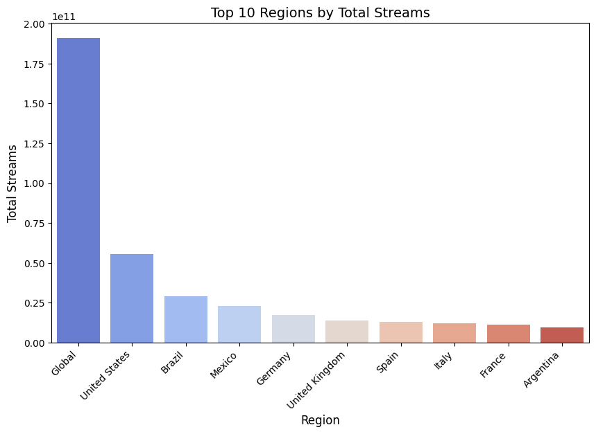
Exploratory Data Analysis
The graph basically displays the top 10 regions including the global data ranked by their total number of streams. The region with the highest total streams is the United States, followed by Brazil, Mexico, and so on.
The top 10 artists based on total streams are led by The Weeknd with 9.88 billion streams, followed by Olivia Rodrigo with 9.52 billion, and Billie Eilish with 7.92 billion streams. Other prominent artists in this list include Dua Lipa, Justin Bieber, and Juice WRLD, showcasing their dominance on the Spotify platform.

Slide 7
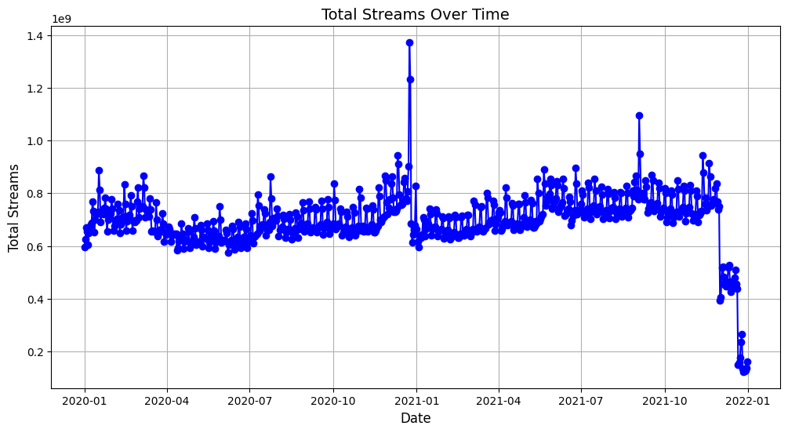
Data Visualization
The graph shows the total number of streams over time, from 2020-01 to 2022-01. It depicts the fluctuations in total streams, with some notable peaks and valleys throughout the time period. It also showcases the overall trend in total stream volume over the course of these two years.

Slide 8
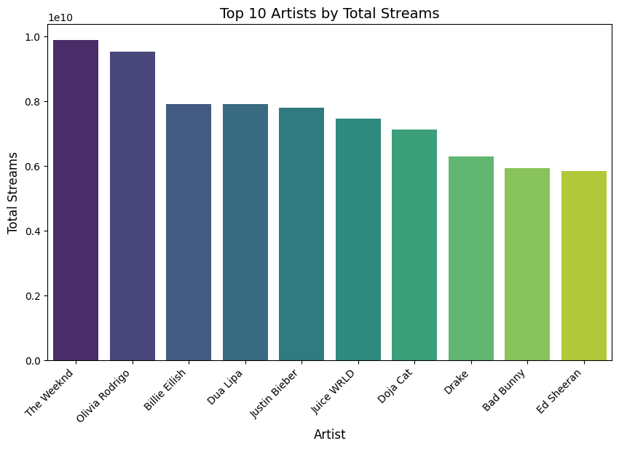
Data Visualization
The graph ranks the top 10 artists by their total number of streams. The artist with the highest total streams is "The Weeknd", followed by "Olivia Rodrigo", "Billie Eilish", and several other popular artists.

Slide 9
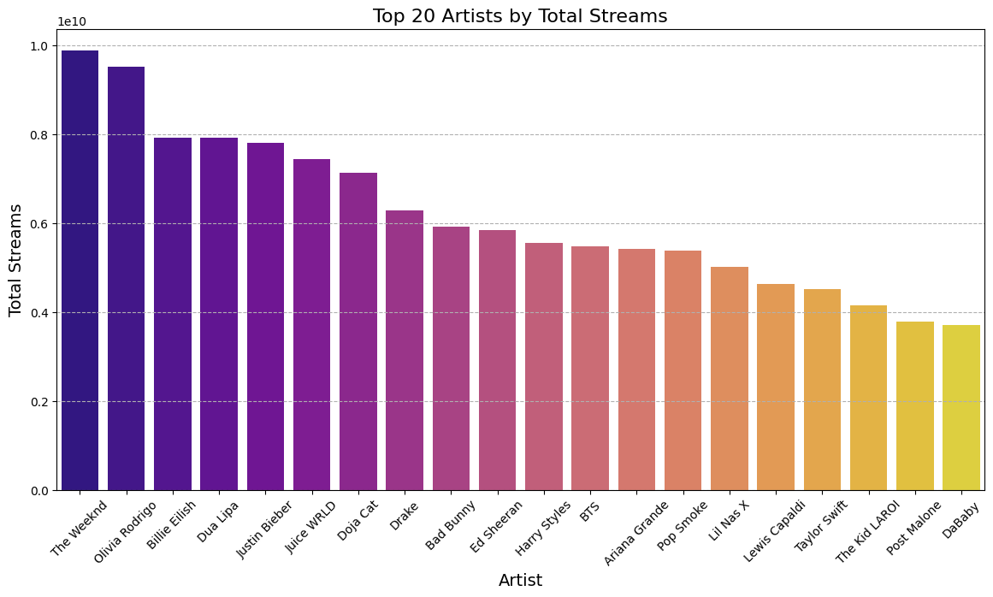
Data Visualization
Quite similar to our previous graph but we are now focusing on top 20 artists.

Slide 10
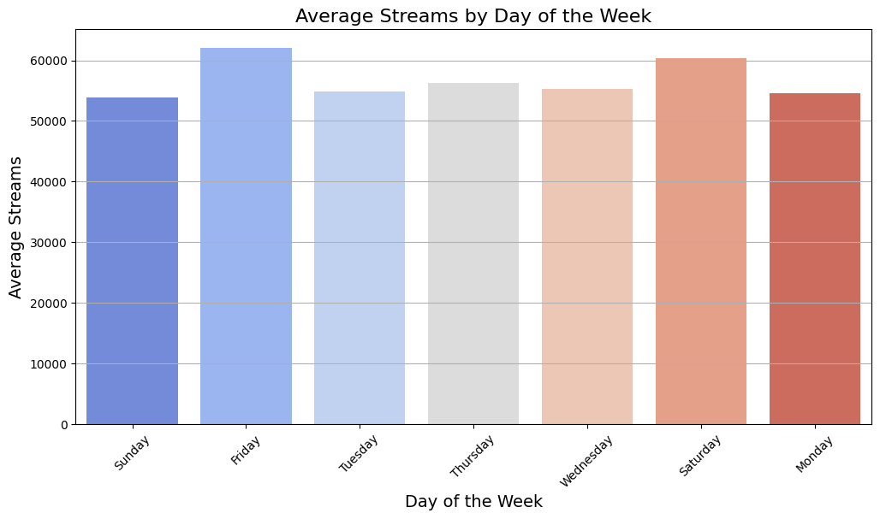
Data Visualization
This bar graph displays the average streams by day of the week. The x-axis shows the different days of the week, while the y-axis represents the average stream volume. The graph highlights the variation in average stream volumes across the different days, with Friday and Saturday having the highest averages suggesting a huge influx of listener over the weekend.

Slide 11
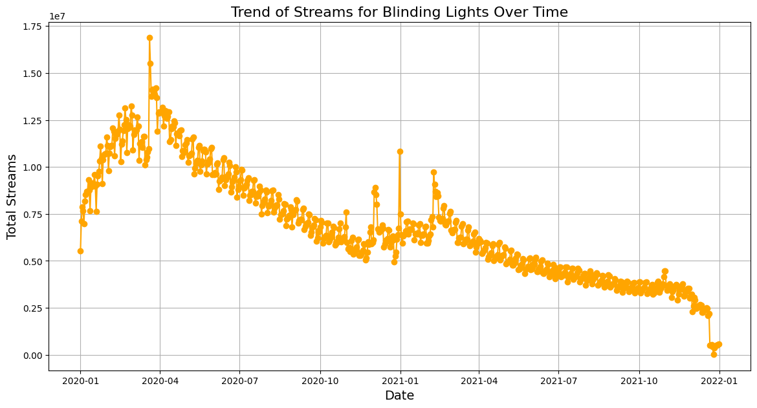
Data Visualization
This line graph depicts the trend of total streams for the song "Blinding Lights" over time. The x-axis shows the date, while the y-axis represents the total streams. The graph illustrates the fluctuations and overall downward trend in the total streams for this particular song over the given time period.

Slide 12
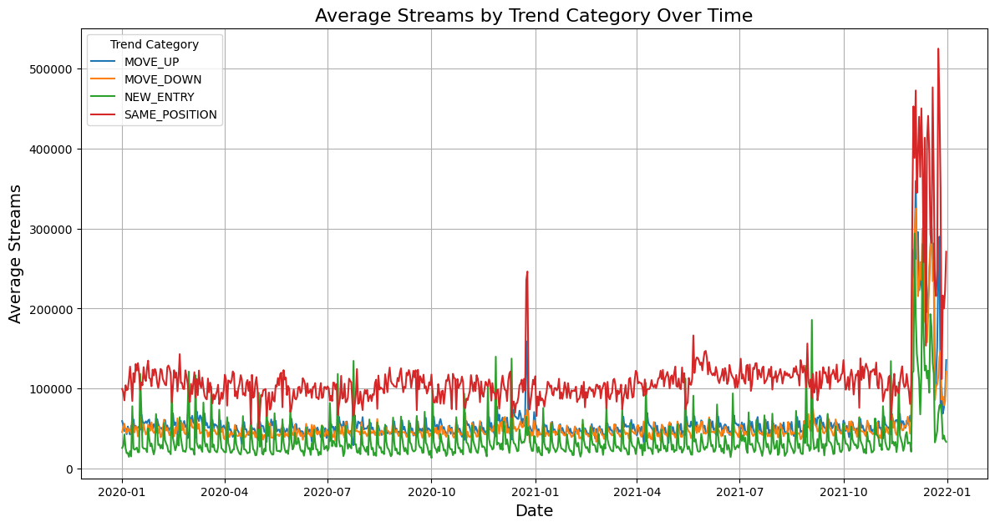
Data Visualization
The graph shows the average number of streams over time, broken down by different trend categories such as "MOVE_UP" - gaining a position, "MOVE_DOWN" - losing a position, "NEW_ENTRY" - getting enough streams to enter the charts, and "SAME_POSITION" - keeping the growth constant. The graph illustrates how the average stream volumes have fluctuated for these different trend categories across the time period from 2020-01 to 2022-01.

Slide 13
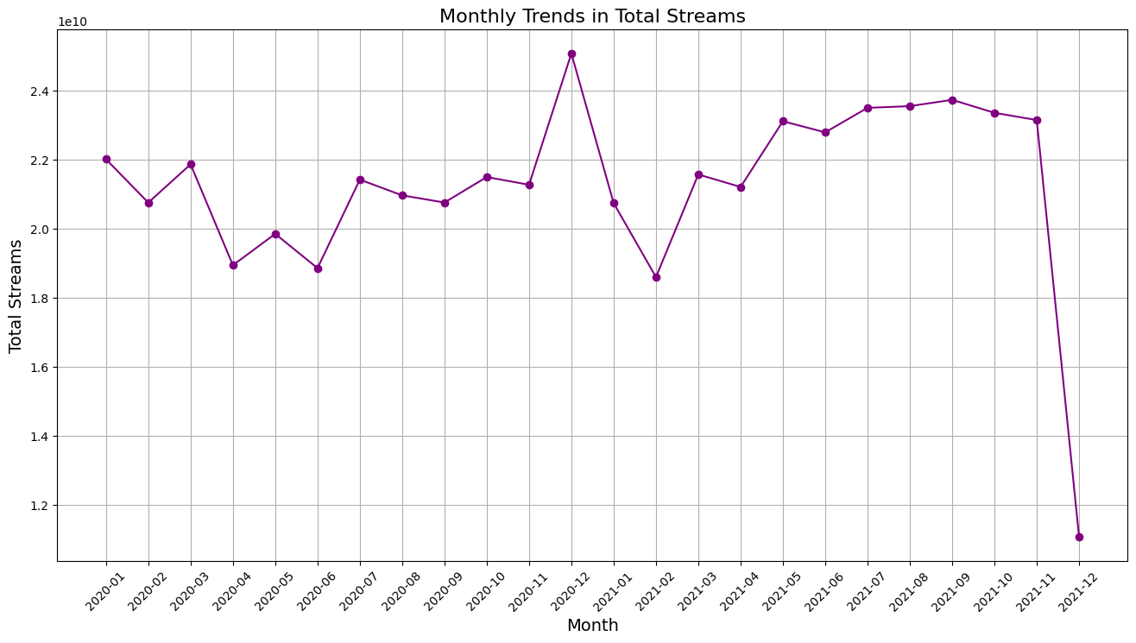
Data Visualization
The monthly trends graph reveals a dynamic and seasonally-influenced landscape, with stream volumes fluctuating dramatically from month to month and an underlying downward trajectory that may be tied to a complex interplay of factors like new music releases, platform updates, and broader market shifts. Digging into the drivers behind these ebb and flow patterns could uncover valuable insights about evolving listener preferences and the state of the industry.

Slide 14
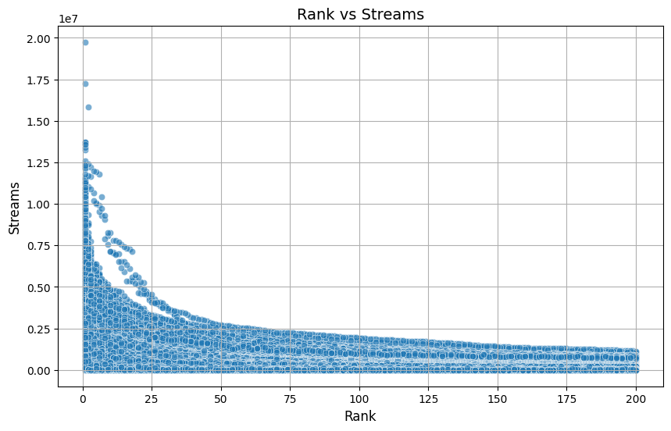
Data Visualization
The graph showcases an exponential decay relationship between an the rank of the song and its total streams, with a high concentration of streams for the top-ranked items and a long tail of lower-ranked items with progressively fewer streams. The data points form distinct horizontal bands suggesting cohorts of items with similar stream volumes, and occasional outliers that seems to be deviating from the overall exponential trend.

Slide 15
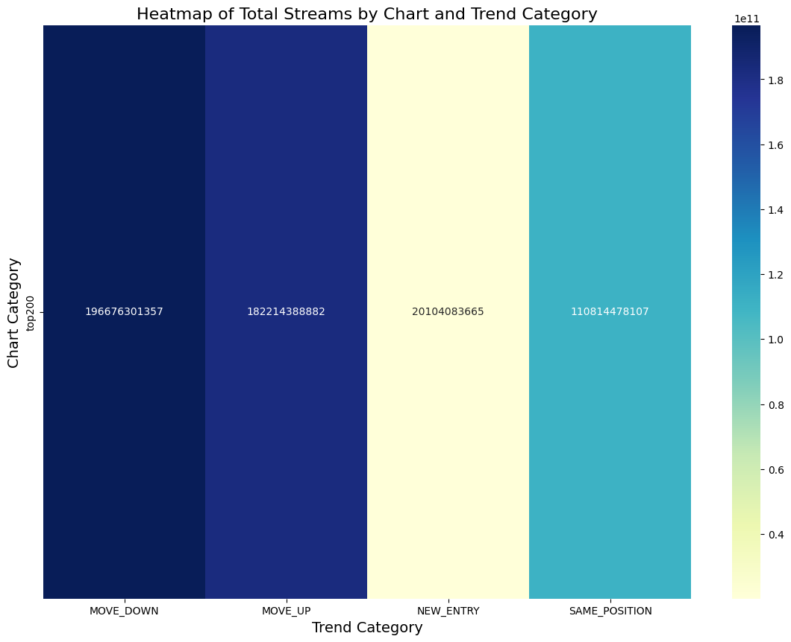
Data Visualization
This heatmap provides a more detailed view of the total stream volumes across different chart and trend categories. The x-axis represents the trend categories (MOVE_DOWN, MOVE_UP, NEW_ENTRY, SAME_POSITION), while the y-axis shows the different chart IDs. The colors in the heatmap indicate the relative magnitude of the total stream values, with darker shades representing higher values.

Slide 16
GraphFrame Analytics
+--------------------+------------------+
| id| pagerank|
+--------------------+------------------+
|Trueno, Taiu, TATOOL|0.9800255708650217|
| Kygo, Sasha Sloan|0.9800255708650217|
| Mc Brunyn, Mc Moana|0.9800255708650217|
|G Herbo, Juice WR...|0.9800255708650217|
| CHUNG HA|0.9800255708650217|
|Cali Y El Dandee,...|0.9800255708650217|
|Keren Peles, Ron ...|0.9800255708650217|
| ANNA|0.9800255708650217|
| Franco126|0.9800255708650217|
| YOASOBI|0.9800255708650217|
| Superfly|0.9800255708650217|
| Snelle, Yade Lauren|0.9800255708650217|
|El Alfa, Farruko,...|0.9800255708650217|
| Parokya Ni Edgar|0.9800255708650217|
|Moira Dela Torre,...|0.9800255708650217|
|ALLMO$T, L.A. GOO...|0.9800255708650217|
| *NSYNC|0.9800255708650217|
| Gedz|0.9800255708650217|
|SB Maffija, White...|0.9800255708650217|
| Reto|0.9800255708650217|
+--------------------+------------------+
only showing top 20 rows
The PageRank analysis identifies multiple artists, including Trueno, Taiu, TATOOL, Kygo, Sasha Sloan, and Mc Brunyn, Mc Moana, with a consistent PageRank value of approximately 0.98. This indicates their central importance within the network of collaborations and connections across the dataset.

Slide 17
Conclusions
This analysis of Spotify's Top 200 reveals key insights into global streaming trends and artist dominance:
Streaming Trends:
Streams fluctuated seasonally, with peaks linked to major releases and holidays.
Fridays and Saturdays saw the highest average streams, reflecting weekend listener behavior.
Artist Dominance:
Bad Bunny appeared most frequently on the charts, while The Weeknd, Olivia Rodrigo, and Billie Eilishled in total streams.
PageRank analysis highlighted artists like Trueno and Kygo for their collaborative influence.
Regional Patterns:
The United States led in total streams, followed by Brazil and Mexico, showcasing the dominance of the US and Latin American markets.
Top Tracks and Correlations:
"Blinding Lights" exhibited long-term popularity, while trends like MOVE_UP and NEW_ENTRY indicated dynamic chart movements.
A weak negative correlation (-0.13) between rank and streams suggests rank impacts streams but is not a sole determinant.
Key Takeaways:
Seasonal and regional trends highlight listener behavior and market dynamics.
Insights into artist and track performance inform industry strategies and future predictions.

Slide 18
Thank You

